Slide 1
Supply Chain Process Optimization Using Linear Programming
Presented By:
Gaurav Kedia

Slide 2
What is Supply Chain Optimization ?
Supply-chain optimization (SCO) aims to ensure the optimal operation of a manufacturing and distribution supply chain.
Supply chain optimization makes the best use of technology and resources like blockchain, AI and IoT to improve efficiency and performance in a supply network.
This includes the optimal placement of inventory within the supply chain, minimizing operating costs including manufacturing costs, transportation costs, and distribution costs

Slide 3
Why is supply chain optimization important?
A well-designed supply chain optimization process addresses the following issues:
Client needs
Competitive advantage
Agility
Sustainability

Slide 4
What is Linear Programming ?
Linear Programming is a method to achieve the best outcome in a mathematical model whose requirement are represented by linear relationship.
Linear Program are easy to solve
The best(optimal) solution is guaranteed to be found(if it exist)

Slide 5
Requirements of LP Problems
Problem Statement
Decision Variable
Constraints
Objective Function

Slide 6
Requirements of LP Problems
Decisions variables: variables that can be numeric or boolean
Objective function: a linear function of the variables that we want to minimize or maximize
Formulate the constraints: a set of equations combining the different decision variables

Slide 7
Example :
Maximize ($15)Chairs + ($20)Tables
Subject to
Large Brick : Chair + 2*Table<=6
Small Brick : 2Chair + 2*Table <=8
and
Chair>=0 ,Table>=0

Slide 8
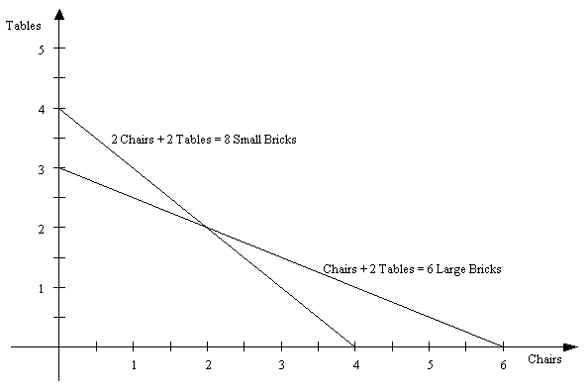

Slide 9
Workforce Planning using Linear Programming
Step 1: Understand the problem (Scenario)
You are an Inbound Manager of a Distribution Center operated by a Third Party Logistics Company for a large retailer.
Your team responsibilities include
Unload Pallets from the Trucks
Scan each pallet and record the received quantity in your Warehouse Management System (WMS)
Put away these pallets to Stock Area
The team’s global productivity is measured each week in (Pallets/Hour).

Slide 10
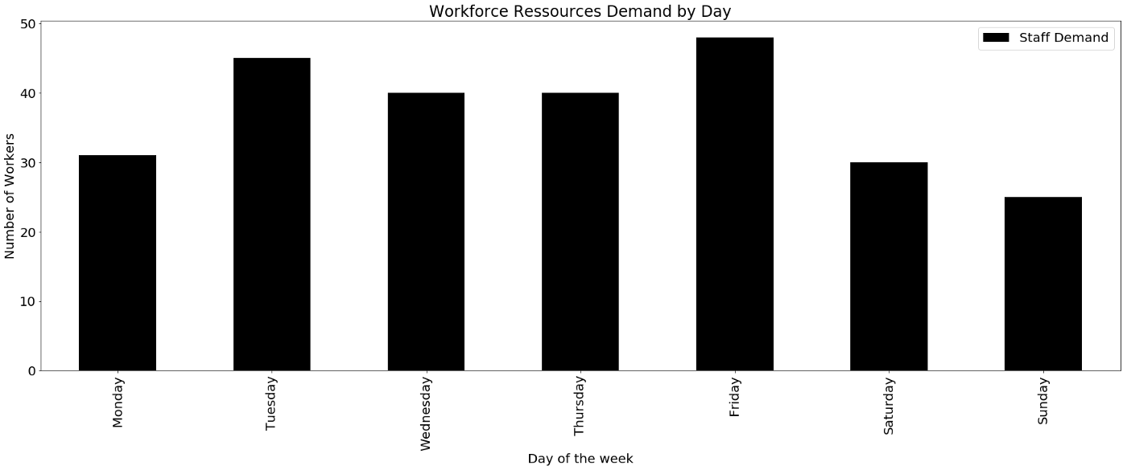
2 .Workforce Sizing

Slide 11
Constraints
Constraint 1: The Supply must meet the demand
If you need 31 workers Monday, you need to secure at least 31 workers for Monday.
Constraint 2: Minimum working time by worker
To ensure employees retention, you need to guarantee a minimum of 5 consecutive working days per week.
Therefore you need to ensure minimum working time for your temporary workers to be an attractive employer.
Constraint 3: Maximum working time by week
Following the local regulations, each worker needs to rest 2 days after 5 consecutive working days.

Slide 12
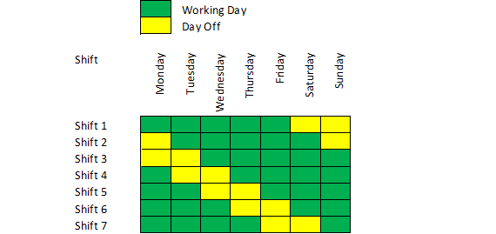
Planning by shift based on constraints listed above
A worker from Shift 1 will start his week Monday and get 2 days off on Friday.

Slide 13
Objective: Minimize the number of workers hired
Following the productivity targets fixed by your manager, you must minimize the number of workers hired. If you do not reach this target your P&L can be impacted, because this productivity has been used to calculate the price invoiced to your customer (retailer).

Slide 14
3. Linear Programming Problem
Variables x[i]: number of temporary workers hired for shift i.
Constraints - For each day the total number of workers on-duty must be higher than the demand
Each worker needs to work a minimum of 5 consecutive days per week
-Each worker needs to have 2 days off after 5 consecutive days of work
Objective functions The total number of temporary workers hired for all shifts i = 1 … 7 should be minimal

Slide 15
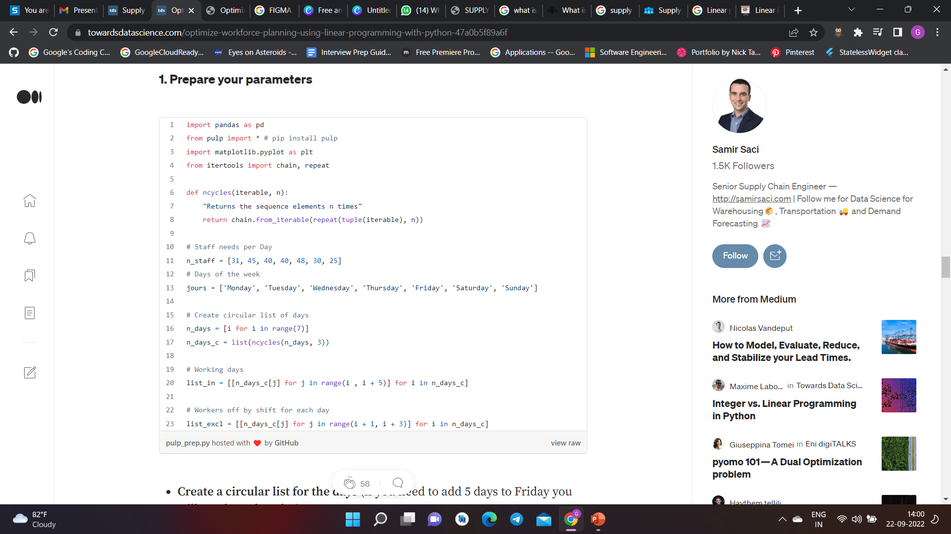
1.Prepare your parameter:

Slide 16
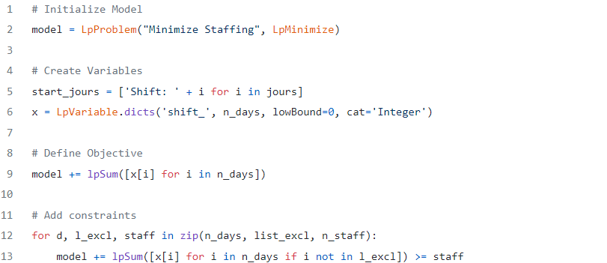
2 . Initialize model, define the objective and add constraints

Slide 17
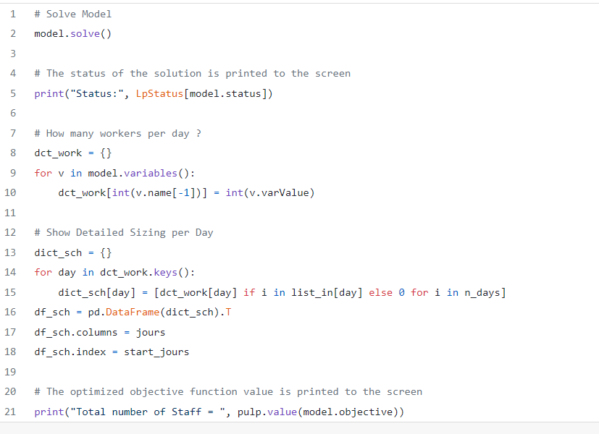
3. Solve your model and analyze the results

Slide 18
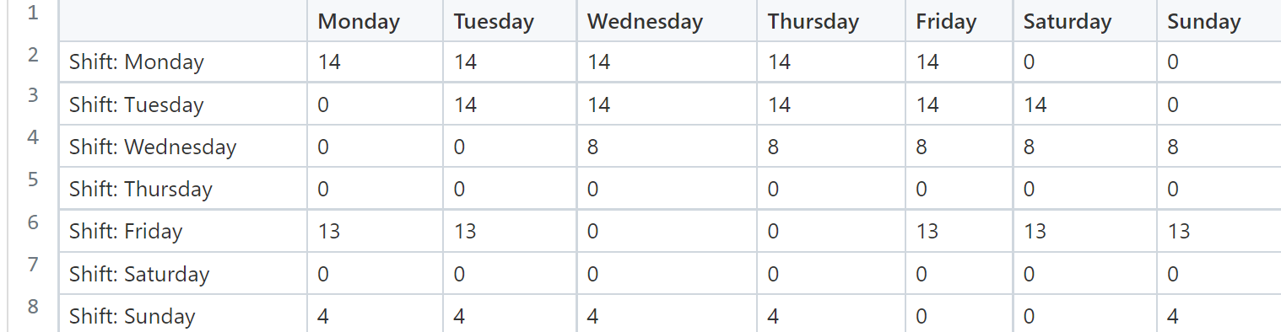
Data :
Total Number of Staff : 53

Slide 19
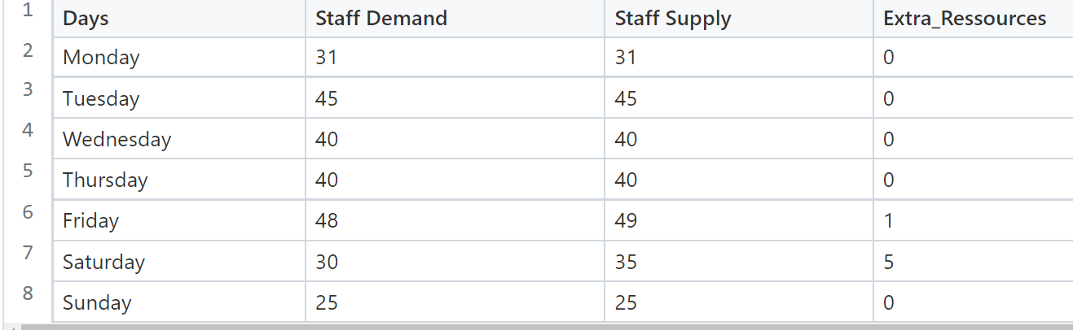
Solution :

Slide 20
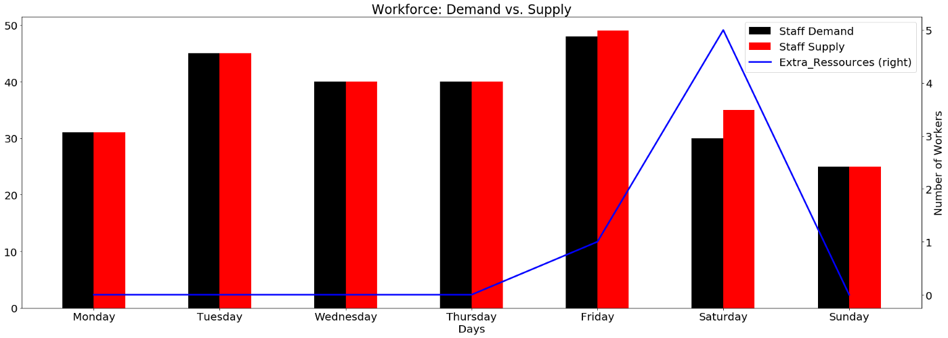
Insights :
Friday : 1 Extra Worker
Saturday : 5 Extra Worker

Slide 21
Thank You!!
Refrences :

